Slide 1
Transformer

Slide 2
Slide credits
Most of these slides were adapted from:
Hung-yi Lee (National Taiwan University)
Kris Kitani (Carnegie Mellon University).
Noah Snavely (Cornell University).
Fei-Fei Li (Stanford University).

Slide 3

Sequence-to-sequence (Seq2seq)
Input a sequence, output a sequence
The output length is determined by model.
Speech
Recognition
How
are
you
N
T
機
器
學
習
Machine
Translation
machine
learning
N
N’
machine
learning
機
器
學
習
Speech
Translation

Slide 4


Hokkien
Speech Recognition
“母湯”
??????? …
(Speech of Hokkien)
Speech
Translation
“不行”
(Speech of Hokkien)
Local soap operas on YouTube (Speech of Hokkien, Chinese subtitle)
Using 1500 hours of data for training

Slide 5
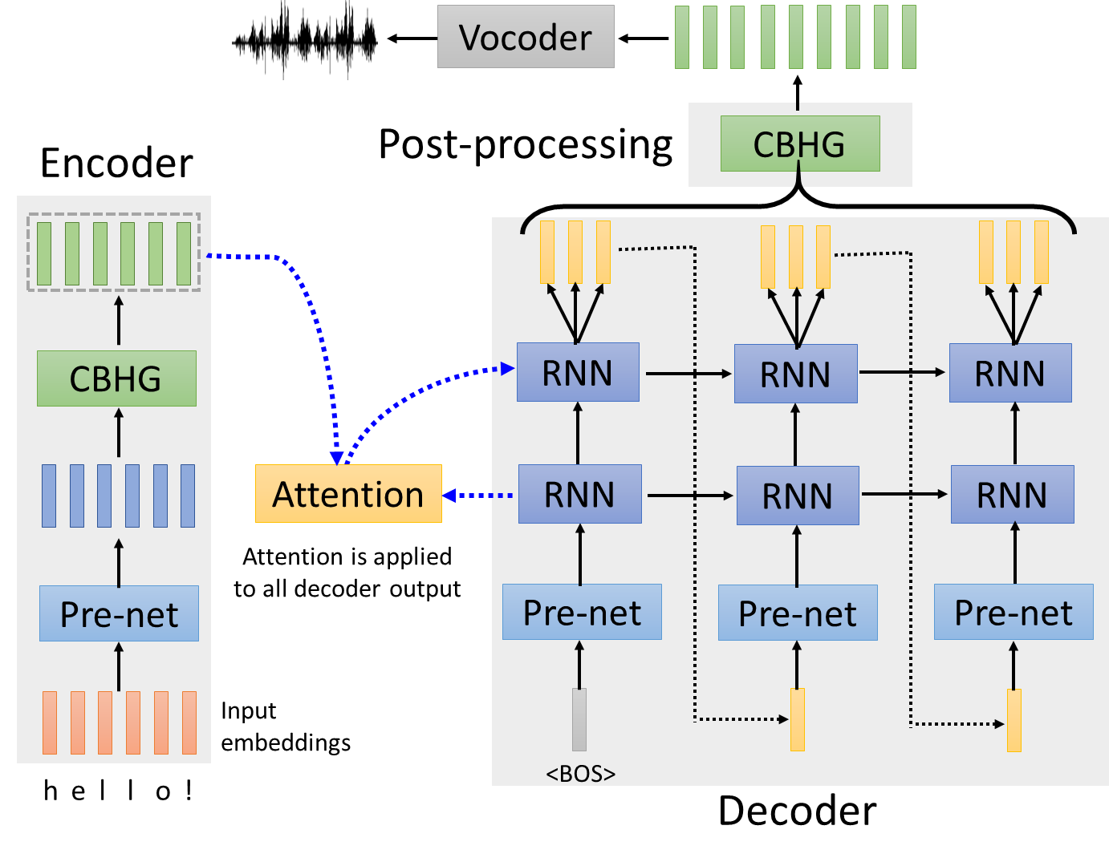
Text-to-Speech (TTS) Synthesis
Taiwanese Speech Synthesis

Slide 6
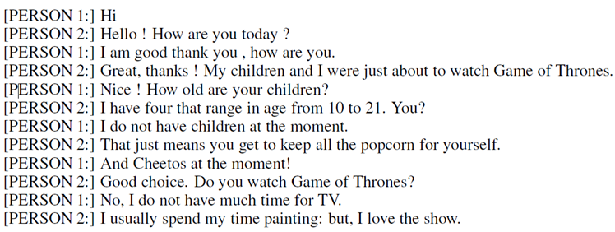
Seq2seq for Chatbot
“Hello! How are you today?”
seq2seq
input
response
“Hi”
Training
data:

Slide 7
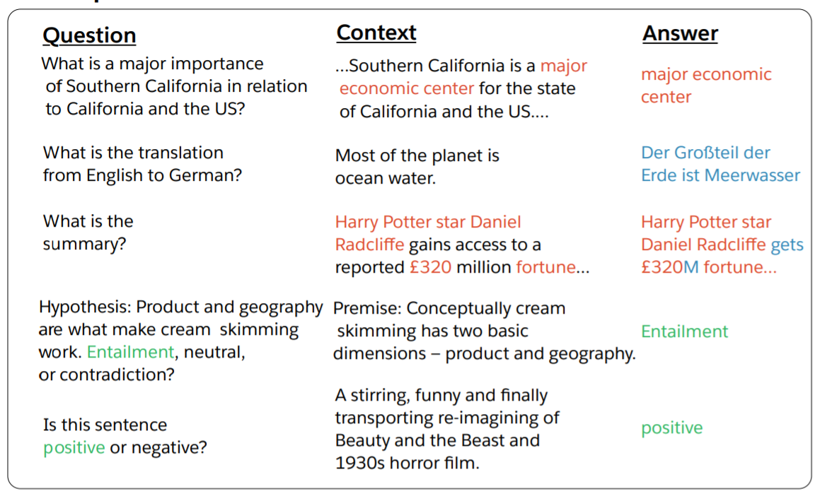
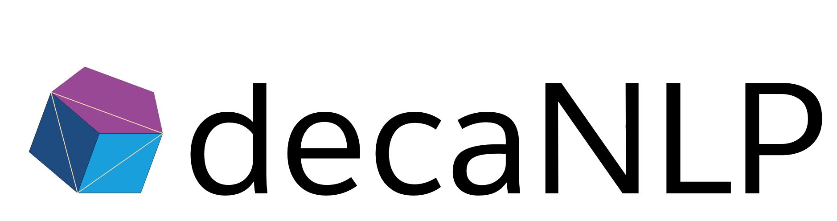
Most Natural Language Processing applications …
Question Answering (QA)
(sentiment analysis)
QA can be done by seq2seq
Seq2seq
question, context
answer
https://arxiv.org/abs/1806.08730
https://arxiv.org/abs/1909.03329

Slide 8
Seq2seq for Syntactic Parsing
Is it a sequence?
S
Model
Output
VP
NP
ADJV
Model
Input
deep learning is very powerful

Slide 9
Seq2seq for Syntactic Parsing
(S
(NP
deep
learning
)
(VP
is
(ADJV
very
powerful
)
)
)
Seq2seq!
S
VP
NP
ADJV
deep learning is very powerful

Slide 10
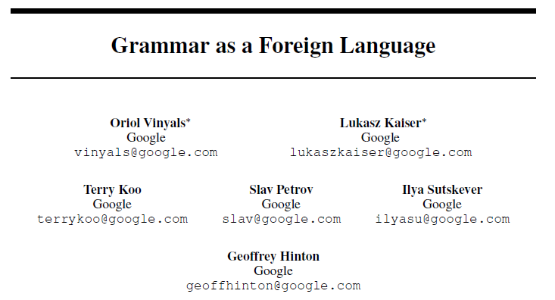
Seq2seq for Syntactic Parsing
(S
(NP
deep
learning
)
(VP
is
(ADJV
very
powerful
)
)
)
https://arxiv.org/abs/1412.7449
deep learning is very powerful

Slide 11

Seq2seq for Multi-label Classification
c.f. Multi-class Classification
An object can belong to multiple classes.
Class 1
Class 1
Class 3
Class 10
Class 3
Class 9
Class 17
Seq2seq
Class 9
Class 7
Class 13
https://arxiv.org/abs/1909.03434
https://arxiv.org/abs/1707.05495

Slide 12
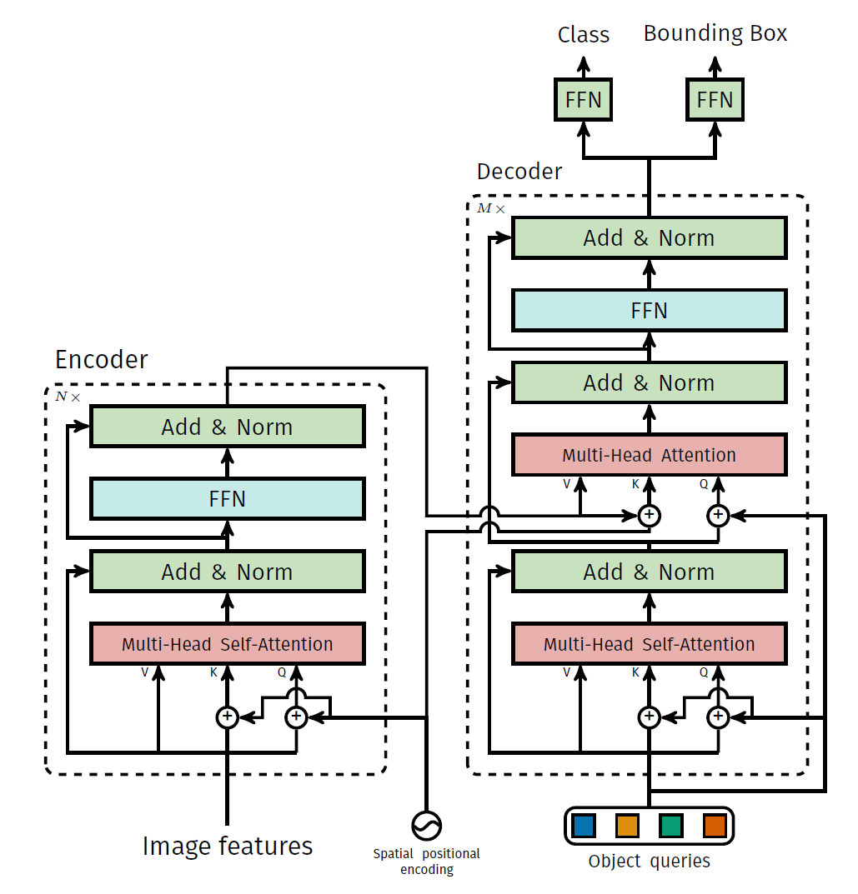
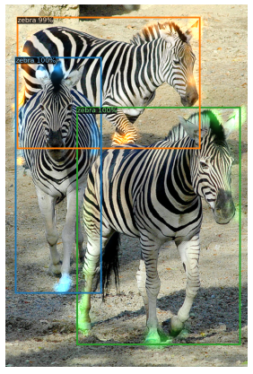
Seq2seq for Object Detection
https://arxiv.org/abs/2005.12872

Slide 13
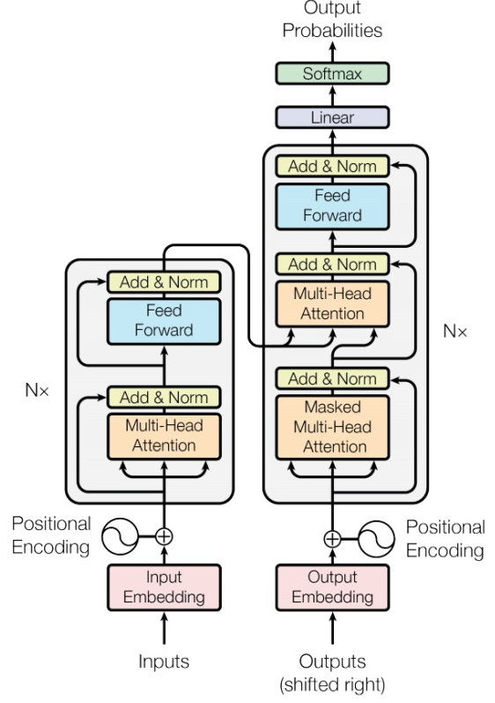

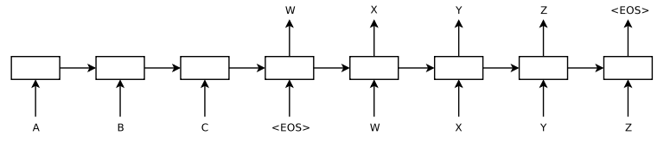
Seq2seq
output sequence
Encoder
Decoder
Input sequence
Sequence to Sequence Learning with Neural Networks
Transformer
https://arxiv.org/abs/1409.3215
https://arxiv.org/abs/1706.03762

Slide 14
Encoder
output sequence
Encoder
Decoder
Input sequence

Slide 15
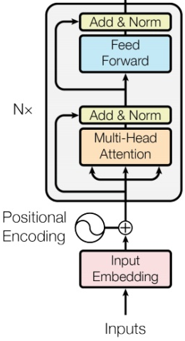








Encoder
Transformer’s Encoder
You can use RNN or CNN.
$$h^{1}$$
$$h^{2}$$
$$h^{3}$$
$$h^{4}$$
Encoder
$$x^{1}$$
$$x^{2}$$
$$x^{3}$$
$$x^{4}$$

Slide 16








$$h^{1}$$
$$h^{2}$$
$$h^{3}$$
$$h^{4}$$
Block
…
…
…
…
FC
FC
FC
FC
Block
Block
Self-attention
$$x^{1}$$
$$x^{2}$$
$$x^{3}$$
$$x^{4}$$

Slide 17


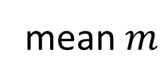





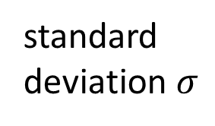
…
$$\left[\begin{aligned}x_{1}^{′} \\ x_{2}^{′} \\ ⋮ \\ x_{K}^{′}\end{aligned}\right]$$
$$x_{i}^{′}=\frac{x_{i}−m}{σ}$$
norm
Layer Norm
norm
norm
https://arxiv.org/abs/1607.06450
+
residual
$$a+b$$
$$\left[\begin{aligned}x_{1} \\ x_{2} \\ ⋮ \\ x_{K}\end{aligned}\right]$$
mean $m$
FC
standard deviation $σ$
$$b$$
+
$$a$$
Self-attention

Slide 18
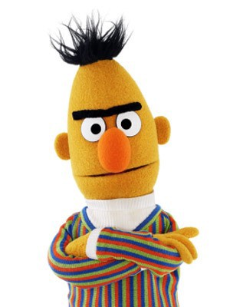
BERT
I use the same network architecture as transformer encoder.
$$h^{1}$$
$$h^{2}$$
$$h^{3}$$
$$h^{4}$$
Encoder
Residual
+ Layer norm
$$x^{1}$$
$$x^{2}$$
$$x^{3}$$
$$x^{4}$$

Slide 19
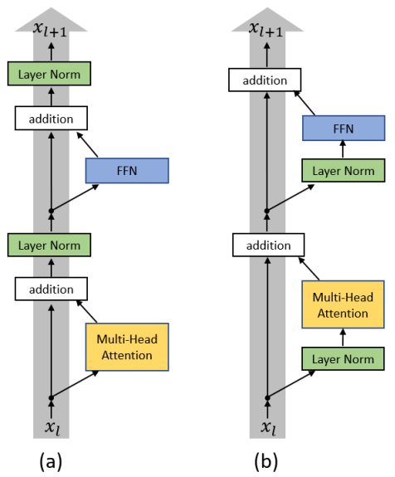
To learn more ……
On Layer Normalization in the Transformer Architecture
https://arxiv.org/abs/2002.04745
PowerNorm: Rethinking Batch Normalization in Transformers
https://arxiv.org/abs/2003.07845

Slide 20
Decoder
output sequence
Encoder
Decoder
Input sequence

Slide 21
Decoder – Autoregressive (AT)
output sequence
Encoder
Decoder
Input sequence

Slide 22
Autoregressive
distribution
(Speech Recognition as example)
love | 0.0
I | 0.8
machine | 0.0
learning | 0.1
…… | ……
I
Size V
max
(common characters)
softmax
Encoder
Decoder
( I love machine learning )
(special token)
START

Slide 23
Autoregressive
I
love
machine
learning
max
max
max
max
Encoder
Decoder
( I love machine learning )
START
I
love
machine

Slide 24
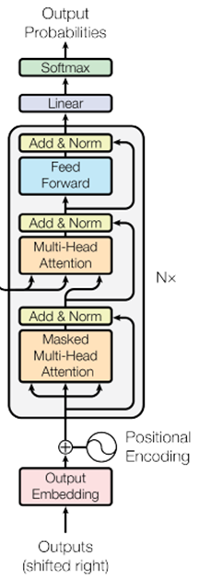
ignore the input from the encoder here ☺
I
love
machine
learning
max
max
max
max
Decoder
START
I
love
machine

Slide 25
Encoder
Decoder

Slide 26








Self-attention
Masked Self-attention
$$b^{1}$$
$$b^{2}$$
$$b^{3}$$
$$b^{4}$$
$$a^{1}$$
$$a^{2}$$
$$a^{3}$$
$$a^{4}$$
Can be either input or a hidden layer

Slide 27

















Self-attention
Masked Self-attention
$$b^{2}$$
$$α_{2,1}^{′}$$
$$α_{2,2}^{′}$$
$$α_{2,3}^{′}$$
$$α_{2,4}^{′}$$
$$q^{1}$$
$$k^{1}$$
$$v^{1}$$
$$q^{2}$$
$$k^{2}$$
$$v^{2}$$
$$q^{3}$$
$$k^{3}$$
$$v^{3}$$
$$q^{4}$$
$$k^{4}$$
$$v^{4}$$
$$a^{1}$$
$$a^{2}$$
$$a^{3}$$
$$a^{4}$$
Consider how does decoder work
Why masked?

Slide 28
Autoregressive
hate
I
love
machine
learning
max
Encoder
Decoder
Decoder
Output
( I love machine learning )
START
love
I
hate
machine

Slide 29
Autoregressive
We do not know the correct output length.
Never stop!
I
love
machine
learning
habit
……
max
max
max
max
max
Encoder
Decoder
( I love machine learning )
START
I
love
machine
learning

Slide 30
distribution
Adding “Stop Token”
I | 0.0
love | 0.8
machine | 0.0
learning | 0.1
…… | ……
END | 0.0
Size V
(common characters)
softmax
Encoder
Decoder
( I love machine learning )
START

Slide 31
Autoregressive
Stop at here!
I
love
machine
learning
END
max
max
max
max
max
Encoder
Decoder
( I love machine learning )
START
I
love
machine
learning

Slide 32
Decoder – Non-autoregressive (NAT)
output sequence
Encoder
Decoder
Input sequence

Slide 33

AT v.s. NAT
w₁
w₃
w₁
END
w₂
END
w₂
w₃
w₄
AT Decoder
NAT Decoder
START
w₁
w₂
w₃
START
START
START
START
How to decide the output length for NAT decoder?
Another predictor for output length
Output a very long sequence, ignore tokens after END
Advantage: parallel, more stable generation (e.g., TTS)
(why? Multi-modality)
NAT is usually worse than AT

Slide 34
Encoder-Decoder
output sequence
Encoder
Decoder
Input sequence

Slide 35
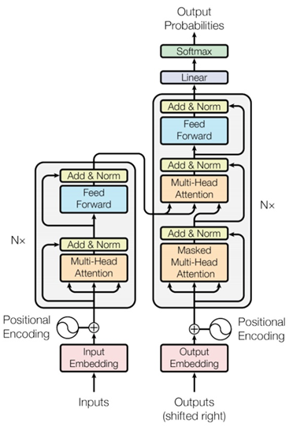
Transformer
Cross attention

Slide 36














FC
$$v$$
$$α_{1}^{′}$$
$$α_{2}^{′}$$
$$α_{3}^{′}$$
Cross attention
$$k^{1}$$
$$v^{1}$$
$$k^{2}$$
$$v^{2}$$
$$k^{3}$$
$$v^{3}$$
$$q$$
$$a^{1}$$
$$a^{2}$$
$$a^{3}$$
Encoder
Self-attention (Mask)
START

Slide 37


FC
$$v′$$
$$α_{1}^{′}$$
$$α_{2}^{′}$$
$$α_{3}^{′}$$
$$k^{1}$$
$$v^{1}$$
$$k^{2}$$
$$v^{2}$$
$$k^{3}$$
$$v^{3}$$
$$q′$$
$$a^{1}$$
$$a^{2}$$
$$a^{3}$$
Encoder
Self-attention (Mask)
START
I

Slide 38
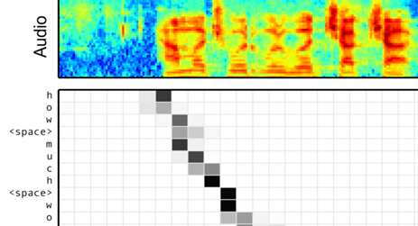
Cross Attention
Listen, attend and spell: A neural network for large vocabulary conversational speech recognition
https://ieeexplore.ieee.org/document/7472621
(This is not transformer.)

Slide 39
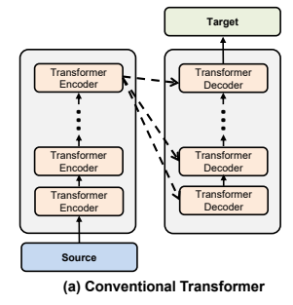
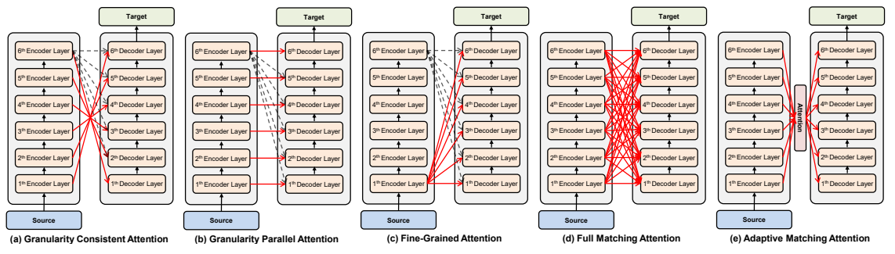
Cross Attention
Source of image:
https://arxiv.org/abs/2005.08081

Slide 40
Training
output sequence
Encoder
Decoder
Input sequence

Slide 41
I | 0
love | 1
machine | 0
learning | 0
…… | ……
Ground truth
distribution
I
I | 0.1
love | 0.7
machine | 0.1
learning | 0.1
…… | ……
Size V
minimize cross entropy
(common characters)
softmax
Encoder
Decoder
Label: I love machine learning
<BOS>

Slide 42
Teacher Forcing: using the ground truth as input.
I
love
machine
learning
<EOS>
minimize cross entropy
Encoder
Decoder
Ground Truth
Label: I love machine learning
<BOS>
I
love
machine
learning

Slide 43
Tips
output sequence
Encoder
Decoder
Input sequence

Slide 44
Copy Mechanism
Machine Translation
Chat-bot
User: Hello，I am Siri
Machine:Siri, hello, nice to meet you.

Slide 45
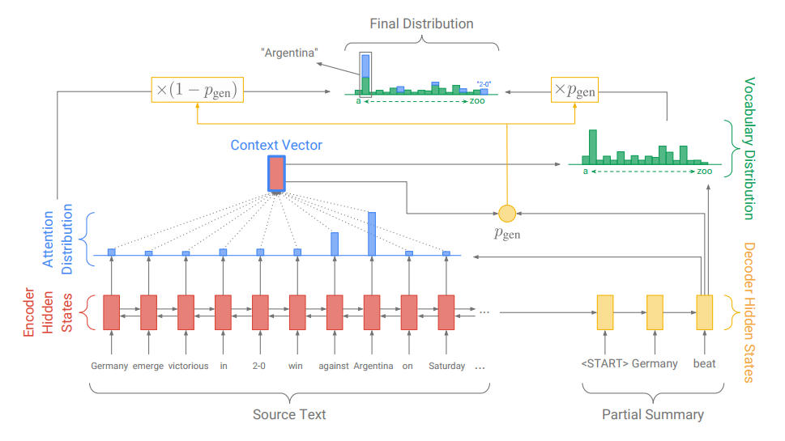
Copy Mechanism
https://arxiv.org/abs/1704.04368
Summarization

Slide 46
Copy Mechanism
Incorporating Copying Mechanism in Sequence-to-Sequence Learning
https://arxiv.org/abs/1603.06393

Slide 47
























Guided Attention
Monotonic Attention
Location-aware attention
In some tasks, input and output are monotonically aligned. For example, speech recognition, TTS, etc.
Attention weights
$$a^{1}$$
$$a^{2}$$
$$a^{3}$$
$$a^{4}$$
$$a^{1}$$
$$a^{2}$$
$$a^{3}$$
$$a^{4}$$
$$a^{1}$$
$$a^{2}$$
$$a^{3}$$
$$a^{4}$$
generate the 1st output
generate the 2nd output
generate the 3rd output
$$a^{1}$$
$$a^{2}$$
$$a^{3}$$
$$a^{4}$$
$$a^{1}$$
$$a^{2}$$
$$a^{3}$$
$$a^{4}$$
$$a^{1}$$
$$a^{2}$$
$$a^{3}$$
$$a^{4}$$
generate the 1st output
generate the 2nd output
Generate the 3rd output
Something wrong!

Slide 48
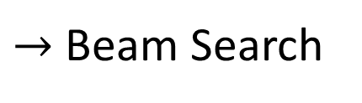
Beam Search
The red path is Greedy Decoding.
The green path is the best one.
Not possible to check all the paths …
$→$ Beam Search
A
B
A
B
A
A
B
B
0.4
0.6
0.9
0.4
A
B
0.6
A
B
0.9
0.6
A
B
0.4
Assume there are only two tokens (V=2).

Slide 49
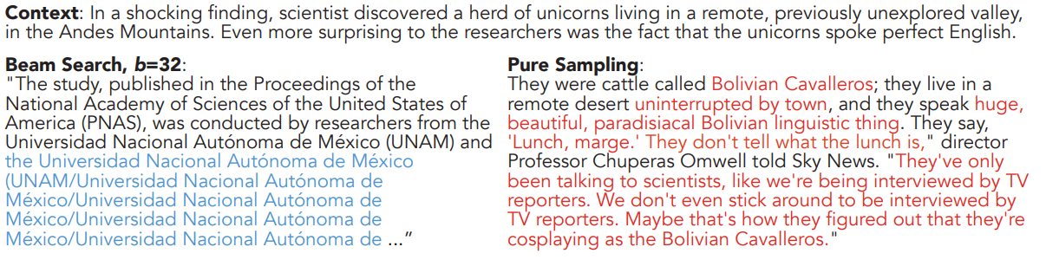
Sampling
The Curious Case of Neural Text Degeneration
https://arxiv.org/abs/1904.09751
Randomness is needed for decoder when generating sequence in some tasks.
Accept that nothing is perfect. True beauty lies in the cracks of imperfection. ☺

Slide 50
Optimizing Evaluation Metrics?
machine
I
machine
I
love
learning
<EOS>
love
learning
<EOS>
BLEU score?
Decoder
Decoder
How to do the optimization?
When you don’t know how to optimize, just use reinforcement learning (RL)!
https://arxiv.org/abs/1511.06732

Slide 51
There is a mismatch! ☹
exposure bias
I
love
machine
I
hate
machine
Decoder
Decoder
START
I
hate
<BOS>
I
love
hate
Ground Truth

Slide 52
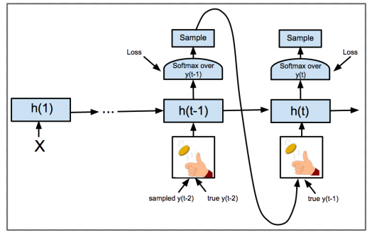
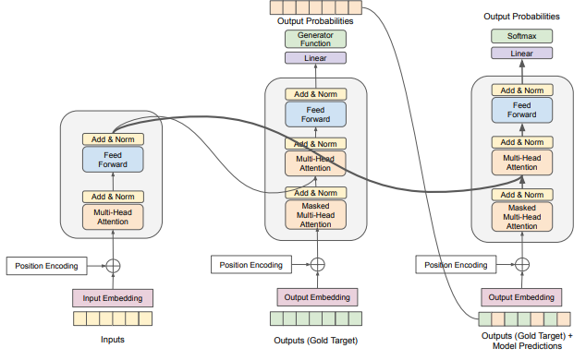
Scheduled Sampling
Original Scheduled Sampling
Scheduled Sampling for Transformer
Parallel Scheduled Sampling
https://arxiv.org/abs/1506.03099
https://arxiv.org/abs/1906.07651
https://arxiv.org/abs/1906.04331

Slide 53
Concluding Remarks:
Transformer

